Slide 1
COMP 7212: Operating/Distributed Systems
Chapter 7: Consistency and Replication
Dr. Myounggyu Won
Reference: Distributed Systems: Principles and Paradigms (3rd Edition)

Slide 2
Overview
Basic Concepts
  Replication
  Consistency
Data-centric consistency models
Client-centric consistency models

Slide 3
Basic Concepts

Slide 4
Introduction
The replication of data is important for distributed systems.
  Enhance reliability
    If one node fails, there is a replica of the node
  Improve performance
    Replication allows data to be stored closer to where it is needed
A major issue is to keep replicas consistent
  When one copy is updated, make sure the other copies are updated as well
  How to implement consistency more efficiently?

Slide 5
Replication as Scaling Technique
Placing copies of data close to processes improves performance
  Helps address the scalability problem
Yet, there is an issue: Keeping multiple copies consistent
  Updating copies dispersed over a large-scale network is a very challenging problem
    High network bandwidth is needed to keep copies up-to-date
    Global synchronization is required, which is costly for a large-scale network
      Frequent communication among nodes to ensure that they maintain the same replicas

Slide 6
Data-Centric Consistency Models
“Data-centric consistency models aim at providing a consistent view on a data store.“

Slide 7
Basic Concepts (1/2)
A data store: shared data, shared database, shared memory, etc.
A data store is physically distributed across multiple machines
Each machine/process that accesses a data store is assumed to have a local copy (or nearby) of the data store
A data operation is classified into write and read operations
A consistency model is a contract between processes and a data store for implementing consistency
  If processes agree to obey certain rules, consistency is ensured.

Slide 8
Basic Concepts (2/2)
The overhead for achieving consistency can be reduced by loosening consistency (i.e., tolerating a certain level of inconsistency)
  Deviation in numerical values to some degree between replicas
  Deviation in staleness (in terms of the time a replica was last updated) between replicas
  Deviation with respect to the ordering of update operations

Slide 9
Conit (1/2)
Yu and Vahdat introduced the concept of a consistency unit (conit) to measure inconsistency in distributed systems.
  A conit defines which data or group of data items is considered when measuring inconsistency among replicas.
Example: Keeping track of a fleet of cars
  In this application, the owner of cars is interested in knowing how much he pays for gas on average.
  When a driver/employee tanks gas, he reports the amount of gas tanked (g), the price paid (p), the total distance moved since he tanked (d).
    These data items may be stored in different replicas.
  These data items g, p, and d form a conit.

Slide 10
Conit (2/2)
Assume this conit is replicated across two servers.
The task of the servers is to keep the conit consistently replicated when operations are performed
  Here, an operation is denoted by <T,R>, where R is the replica and T is the local time of operation.

Slide 11
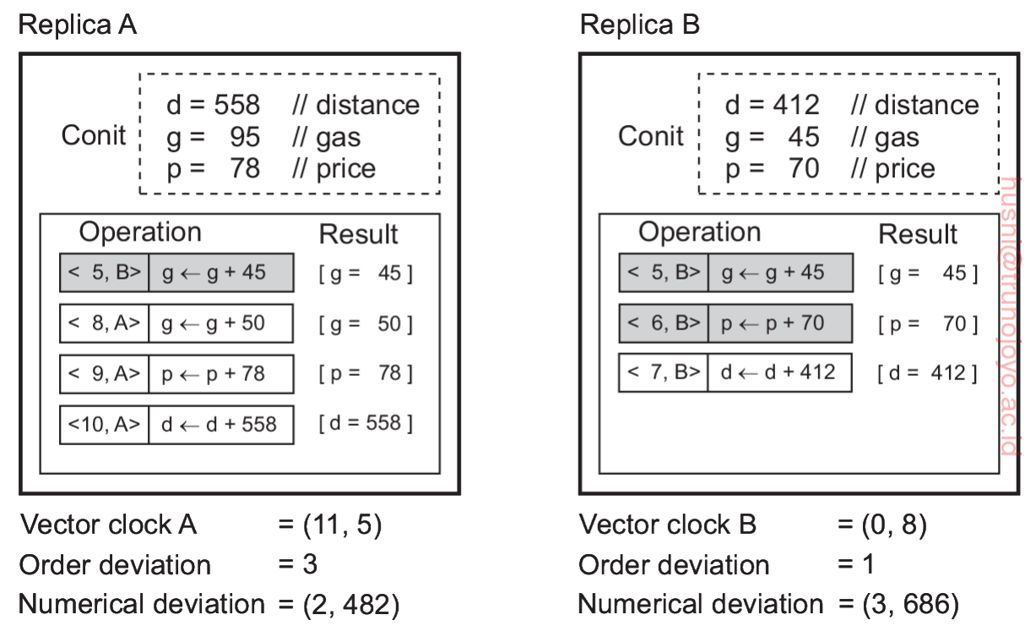
Conit: Example (1/2)
Replica A receives one operation from replica B and performs three local operations.
Replica A has one committed operation.
  Committed operations: Their ordering is stable and will not change.
  Uncommitted operations: Their ordering may still change when Replica B synchronizes with other replicas.
Replica A maintains its conit that reflects the four local operations (regardless of whether the operations are committed or not).

Slide 12
Conit: Example (2/2)
Replica A’s vector clock is (11,5)
  The latest local operation was performed at 10. And the local clock was advanced by 1 due to that operation.
  And received the B’s operation at B’s local time 5.
Replica A’s order deviation is 3 (i.e., three operations are not committed).
Replica A’s numerical deviation is (2,482) since it has not seen the two operations of B with a total units of 70+412=482.

Slide 13
Consistency Contract
We can specify a consistency scheme by varying the inconsistency levels using these notations (i.e., order deviation, time deviation, and numerical deviation)
  e.g., restrict the order derivation by a certain value.
  e.g., specify that two replicas never numerically deviate by more than 1000 units.

Slide 14
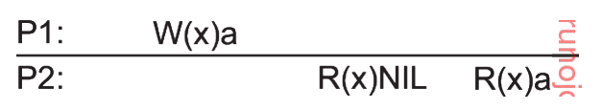
Consistent Ordering of Operations (1/5)
Now, based on the conit, let us discuss different kinds of consistency models/schemes.
  Sequential, causal, and eventual consistency models
Notations
    W_{i}(x)a: process P_{i} writes value a to data item x.
    R_{i}(x)b: process P_{i} reads x and returns value b.
    The process index i can be omitted if it is clear from the context.
  Each data item has the initial value NIL.
x axis : time
It took some time to propagate the update (i.e., ‘a’ written to x by P1)

Slide 15
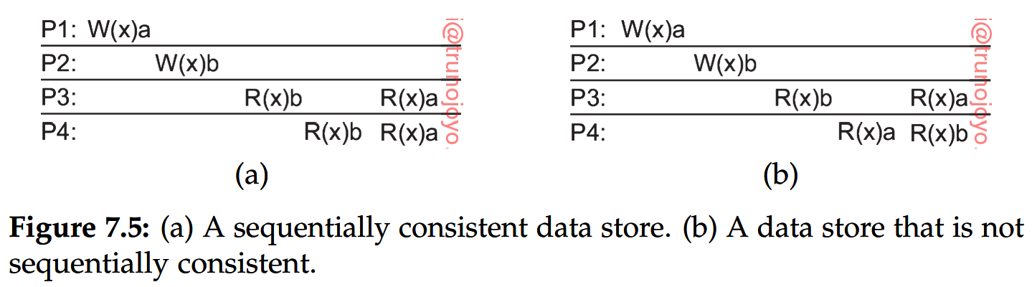
Consistent Ordering of Operations (2/5)
Sequential consistency cont.
  A data store is said to be sequentially consistent when it satisfies the following condition:
    When processes run concurrently on different machines, their read and write operations can occur in different orders. However, all processes must observe the same order of operations, regardless of the actual execution order.
Both P3 and P4 see that W(x)b takes place before W(x)a
P4 sees a different order of operations

Slide 16
Consistent Ordering of Operations (3/5)
Causal consistency
  It makes a distinction between events that are causally related and those that are not (i.e., an order of operations only matters for causally related operations).
    If event b is caused (or influenced) by an earlier event a, causality requires that everyone else first see a then b.
    However, the order of events that everyone else sees does not matter if no causality is found between the two events.
  For example, if two processes simply write two different values to different data items, they are not causally related. These operations are said to be concurrent.

Slide 17
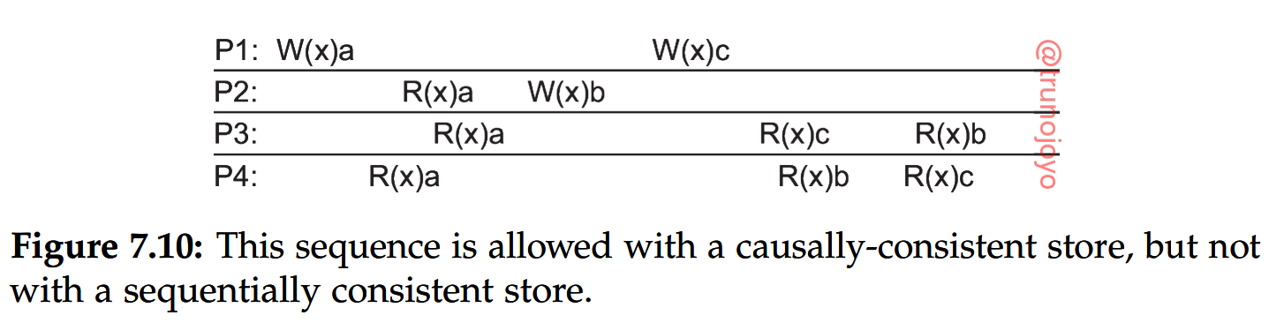
Consistent Ordering of Operations (4/5)
Causal consistency cont.
  Example
Q2: Are these two ops causally related?
Q1: are W(x)a and R(X)a causally related?
Q3: Is this a causally consistent data store?
Q4: In the causally consistent model, processes
are not required to see this particular order
of ops. Is this true?

Slide 18
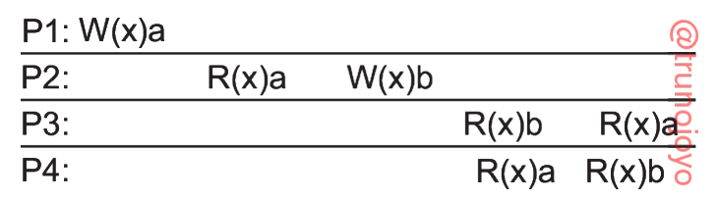
Consistent Ordering of Operations (5/5)
Causal consistency cont.
  Example
W(x)b depends on R(x)a because it happens later on the same process.
Therefore W(x)a and W(x)b are causally related.
In other words, since W(x)a and R(x)a are causally related,
and R(X)a and W(X)b are causally related, therefore
W(X)a and W(X)b are causally related.
Violation of the causal
consistency

Slide 19
Eventual Consistency
There are systems that tolerate relatively high inconsistency
  e.g., database systems where most processes hardly ever perform update operations.
  e.g., the Web where the single authority like a webmaster makes an update.
For such systems, the eventual consistency model can be used.
  Changes made in one part of the distributed system may not be immediately visible to all users or parts of the system.
  Systems using eventual consistency can operate faster and remain available even during network partitions or server failures, as they do not require immediate consistency across all nodes for every operation.
  Eventually, the system will converge to a consistent state (although it may take long)

Slide 20
Client-Centric Consistency Models
“Consistency is achieved from the perspective of the clients.”

Slide 21
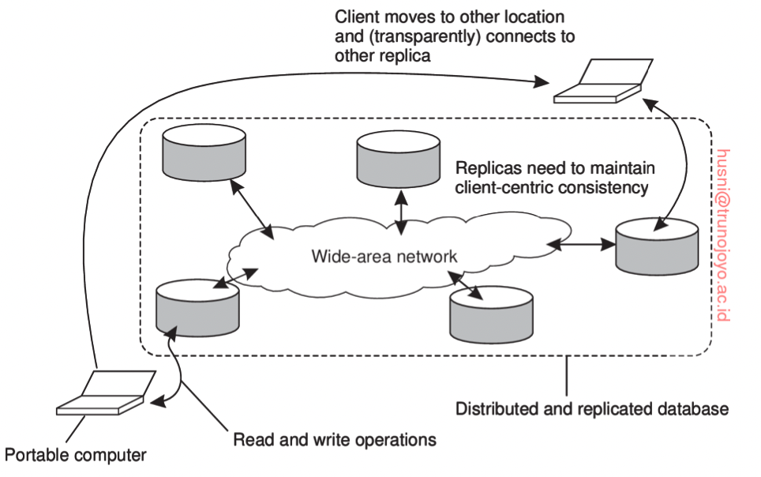
Basic Concept
The client-centric consistency model provides consistency focusing on a client.
  As long as consistency is guaranteed for a client, it is not necessary to maintain consistency across all replicas. Also, we do not need to provide consistency on data items that are not related to those that the client accesses.
Note that not all replicas
are required to maintain
consistency
(i.e., data-centric consistency)

Slide 22
Notations
x_{i} denotes the version i of data item x.
WS(x_{i}) means that the version x_{i} is the result of a series of write operations.
  In particular, W(x_{i}) means a single write operation on x_{i}.
  Also, WS_{i}(x_{i}) means that a series of write operations is performed by process P_{i}.
WS(x_{i};x_{j}) means that x_{j} is the result of a series of write operations performed on the version x_{i}.
  Read as x_{j} follows from x_{i}.
If we do not know if x_{j} follows from x_{i}, use WS(x_{i}|x_{j}).

Slide 23
Client-Centric Consistency Models
Monotonic Reads Model
Monotonic Writes Model
Read Your Writes Model
Writes Follow Reads Model

Slide 24
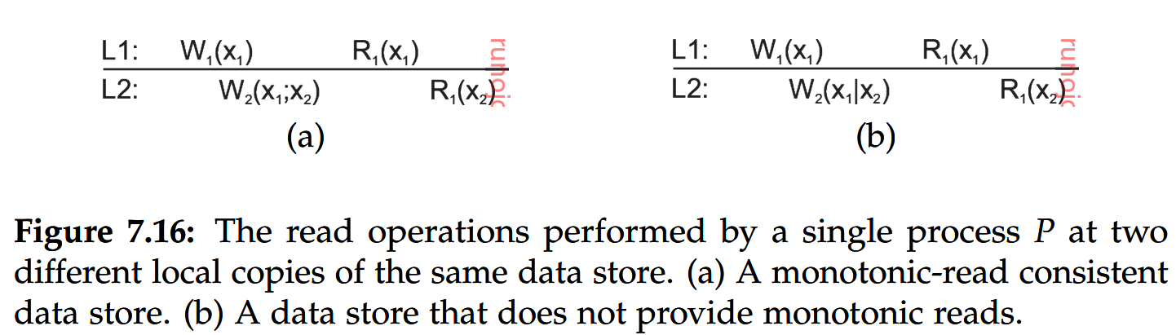
Monotonic Reads Model
Monotonic-read consistency guarantees that once a process (client) has seen/read a value of x, the same process will never see an older version of x.
  e.g., a distributed e-mail database
    A client reads an email in LA; the client moves to NYC; the client should see the mail which was read in LA, ‘marked as read’.
Example
Process P₂ produces x₂ that does not follow from x_{1.}
This means that x₂ is not the new version of x₁.
Local data stores L1 and L2
P₁ reads a different version. Still monotonic reads consistency because
x₁ has been successfully propagated and P₂ wrote x₂ on it, which
means that x2 is a newer version of x1.
P₁ SHOUD SEE the version x₁

Slide 25
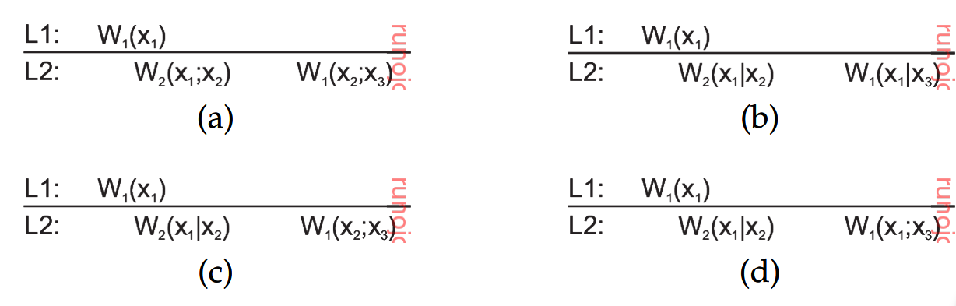
Monotonic Writes Model
A write operation by a process (client) on a data item x is completed before any successive write operation on x by the same process.
More formally, consider two successive write operations W(x_{i}) and W(x_{j}) by the same process. Then, regardless where (i.e., at a different data store) W(x_{j}) takes place, it should be W(x_{i};x_{j}).
Producing x₃ concurrently to x₁.
Not guaranteed that write to x₁
is completed.
Producing x₂ does not follow from x₁
, i.e., propagation of x₁ is not guaranteed.
MW Not Guaranteed
A new version x₃ is produced based on the fact that
the version x₁ becomes available, although P₂ writes
a new version x₂
Still not sure if the write operation on x₁ is
completed.

Slide 26
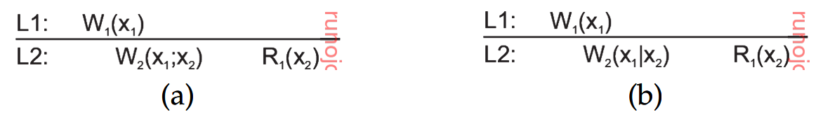
Read Your Writes Model
A data store is said to provide read-your-writes consistency, if the following condition holds
  The effect of a write operation by a process on data item x will always be seen by a successive read operation on x by the same process.
The effect of the previous write operation by P₁ is not clear
, because P₂ performs the write operation in parallel.

Slide 27
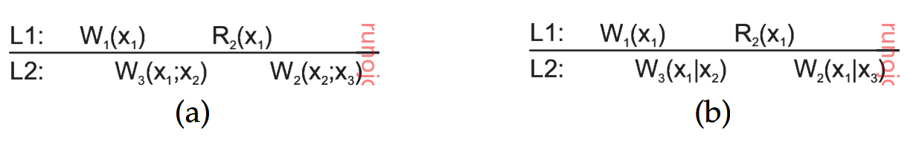
Writes Follow Reads Model
A data store is said to provide writes-follow-reads consistency, if the following condition holds
  Any successive write operation by a process on a data item x will be performed on a copy of x that is up to date with the value most recently read by that process
The most recently seen value of x by P₂ is x₁.
Therefore, P₂ should perform the write operation
on the most up-to-date version x₁.
Meanwhile, since P₃ has performed the write operation on x₁,
The most up-to-date version is x₂.
It is unclear if x₁ is the up-to-date version due to the concurrent write operation by P₃

